Slide 1
THROUGH THE LOOKING GLASS(DOOR)
Abhi A, Preetika Srivastava, Tiffany Sung, Sherlley Loo, Helena Shi
Notes:
Hi guys!
Think back to Friday mornings, 8am bright and early with career services. We’ve heard a lot about how to GET a job, but fast forward a few months and there are going to be offers left and right…how do we decide which one to choose?
Our team decided to take a peek through the looking glass(…door) by scraping glassdoor & getting some insights on what people working there are saying about their companies.

Slide 2


Job-seeking?
What companies are the best/worst according to Glassdoor reviews?
Notes:
Of course we’re personal stakeholders in this question, but what about from a company’s POV?
Personal standpoint: we may all think about working for these companies in the future and/or buy their products, so we get to evaluate them. We can be The Bachelor/Bachelorette and not the contestants on The Bachelor
Company standpoint: if these companies are having turnover and retention issues, this could have an impact of business productivity and costs. Looking at what employees are having problems with can help companies indirectly increase their overall sales/revenue.

Slide 3





2.1K
3.5
13K
4.0
27K
3.8
9.6K
4.4
12K
3.8
Notes:
Scraped Data from GlassDoor
Average rating of each company on glassdoor
Chose these companies on the criteria of:
# of reviews
Potential that we might want to work there
Looking for a story!

Slide 4
Process of Data Analysis
lift scores
topic modeling
cosine similarity
sentiment analysis
Notes:
We’ll just skim over our data analysis process so we can get into the fun insights and stories we found!
First calculated the lift score between pros/cons attributes and 5 company criteria categories (that glassdoor factors into their rating; WLB, Culture value, etc.)
We then used LDA and did topic modeling to understand what employees perceived as pros/cons, and basically capture the chatter around companies. Going further, we then ran cosine similarity of pros & cons to the companys’ mission statements and care values to see: are these companies really practicing what they preach, or is it all talk? And lastly, we ran a sentiment analysis over all reviews to capture – how do people across various locations and roles feel about the company.
Lift:
Calculate lift scores by interacting "Pros and Cons Attributes" with "Company Categories"
Five Categories (Work life balance, Culture/ Value, Career Opportunity, Company Benefit, Senior Management)
Topic Modeling
We used LDA to do model for topics in unstructured review data. This helps us in identifying what employees perceive to be the positives and negatives of their respective companies. Capture the chatter around the companies.
Code here
Cosine Similarity
Comparing company values to positive and negative reviews on Glassdoor. This enables us to classify the sentiment associated with company values. Code here
Sentiment Analysis
How do employees across job titles and locations feel about the company?
We combine the positive and negative ratings to get a true assessment of employee sentiment

Slide 5
“Winning Together: We believe in and value our people. We perform better, are smarter, and have more fun working as a team than as individuals.”

Slide 6

Sentiment Analysis Score: 0.49
Great Work-Life Balance, Flexible WFH
High Value of Teamwork
Low Salary & Benefits
Slow Growth
Low Integrity of Senior Management
Notes:
Dell loves Austin & Round Rock, aka Texas
In terms of Job Roles manager or sales is good
Software engineering is bad everywhere but texas

Slide 7
“Being good stewards of our brand and stockholder value”
Notes:
Within teams and being client forward
Didn’t include Teamwork Negative Sentiment bc difference btwn 0.047 and 0.059 isn’t that high? Should I keep it?

Slide 8
Sentiment Analysis Score: 0.57
Emphasis on Stewardship
Strong on-the-job Training
Lack of Teamwork
Notes:
And those idea reflected in the analysis we did.
Pros:
Lift Score:
“Steward” relatively high ratio w/ “Culture value, company benefit, senior management, career opportunities”
Sentiment: super high positive sentiment “Being good stewards”
Topic Modeling: STRONG TRAINING,
Lift Score: “professional” w/ Career Opportunity;
Cons:
Topic Modeling:
Lift Score: less with cultural value(team, people)’
Interesting insights
Stock Brokers at Schwab are the happiest. Reflects its "customer first" culture.Austin office of Schwab has one of the lowest sentiments
Operations specialist: Happy in Austin
Senior Managers: Happy in almost all the places except in Phoenix, AZ

Slide 9
“We believe that we’re on the face of the Earth to make great products.”

Slide 10
Sentiment Analysis Score: 0.59
Own their Tech & are Proud of their Products
Individual based & lack Teamwork
Notes:
process

Slide 11
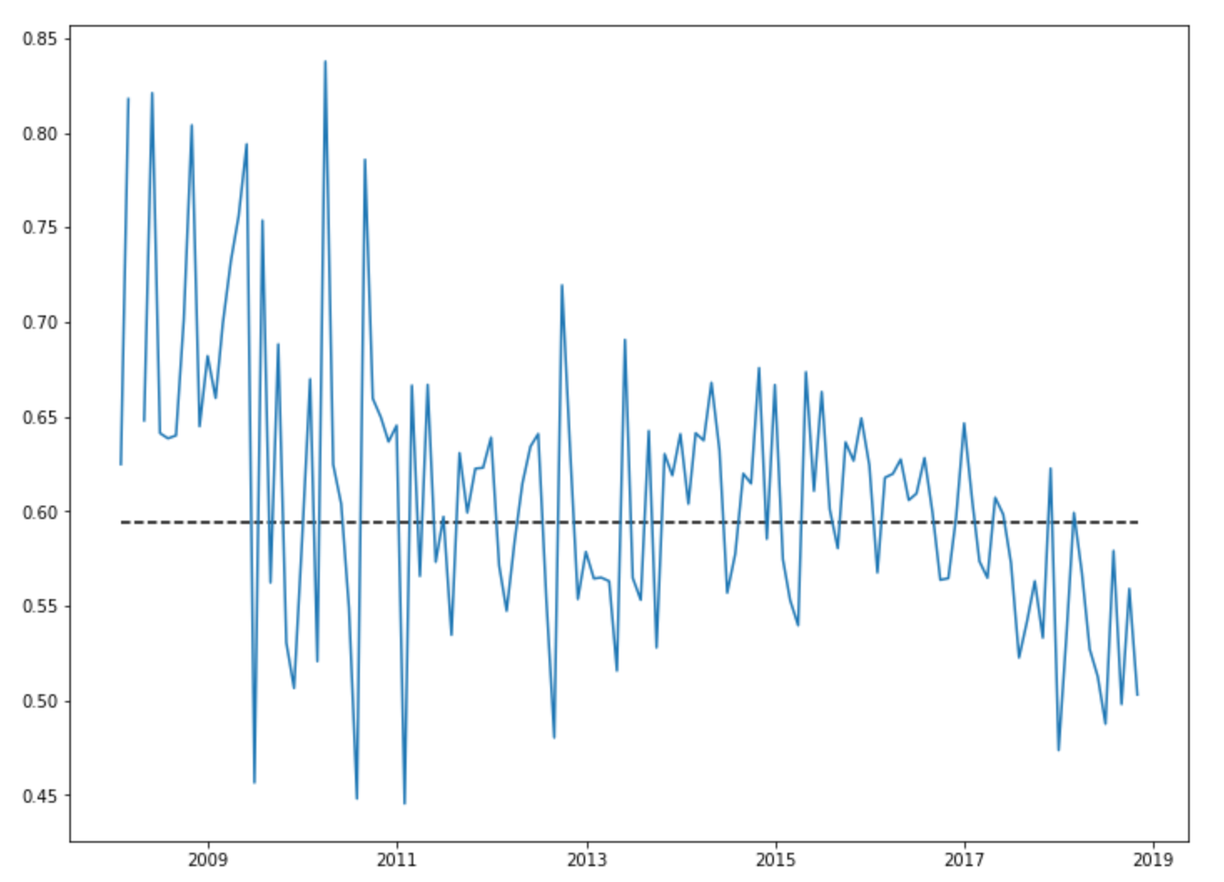
Extremely High SA for Austin, TX Apple Genius!
Software Engineers tracked bad sentiment across all locations
Notes:
Apple over the past 10 years - "not innovating as much", providing a lot more services, "may be past prime/peak“
Over time sentiment score goes down
Could be related to lack of innovation?
Software engineers not popular

Slide 12
“Leaders start with the customer...They work vigorously to earn and keep customer trust. Although leaders pay attention to competitors, they obsess over customers.”

Slide 13
Sentiment Analysis Score: 0.44
Proud of their Customer Obsessed Culture
Learning with Smart People & Quality Projects
Frugal & lack of company benefits
Friction w/ Senior Management
Notes:
process

Slide 14
Software Centers in Seattle & India
Warehouses in
California & MaryLand
Notes:
Warehouses:
Baltimore (Maryland)
Moreno Valley California
San Bernardino California
Software – Seattle + India
Software engineers are happy, but warehouse associates, packers and pickers are miserable. Amazon overall has lower sentiment scores. Upper management happier than lower management / non-management. This is reflected in location as well. Locations which houses tech are happy, DCs and Fulfilment centers are unhappy

Slide 15
“We want to work with great people
We hire great people and expect a lot from them
We create an environment where people can flourish and grow
We treat people with fairness and respect
We challenge each other’s ideas openly
We value diversity in people and ideas
We are a quantitative company that uses data to make decisions”

Slide 16
Sentiment Analysis Score: 0.60
Great Benefits, Work-Life Balance
Smart Network & High Growth
Problems with Middle Management & Micromanagement
Notes:
IN US is happy
But offshore except UK is happy
Common in India bc they feel like they are away from leadership

Slide 17
Notes:
Analysts: happy in UK. High ratings for London, IrelandProduct Manager: happy in UK, very unsatisfactory in Los AngelesSoftware Eng: Happy in London, Dublin. Not so happy in Hyd India

Slide 18


Software & Tech Roles
Avoid Middle Management
Go here to Retire!
Notes:
Work life balance, Culture/ Value, Career Opportunity, Company Benefit,
Senior Management
For Tech roles (Software not UX) go to Amazon not Apple
If you’re a Middle Manager, avoid Google
Upper Management – try to land at Dell or Schwab & retire in Austin

Slide 19
Thanks!
Any questions?
Full analysis & code: https://github.com/abhinaya08/text_analytics/tree/master/Project
Notes:
LINK GITHUB

